Slide 1
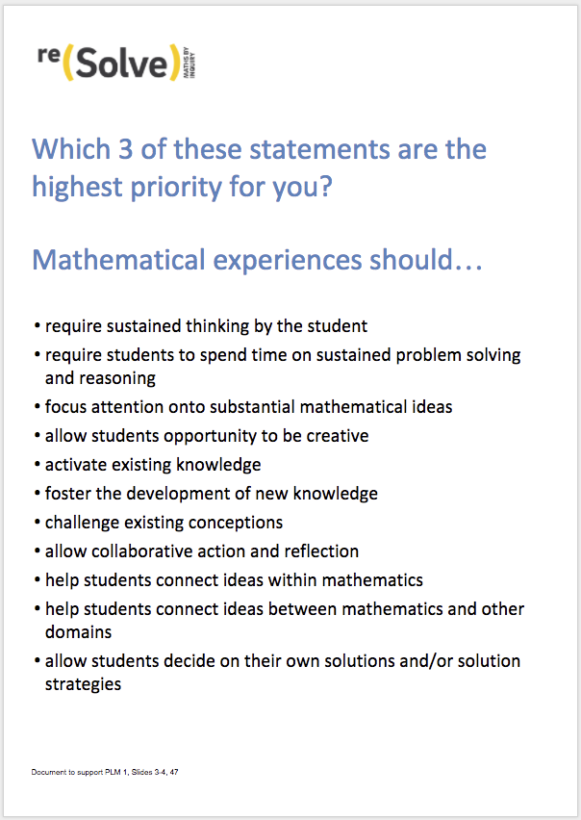
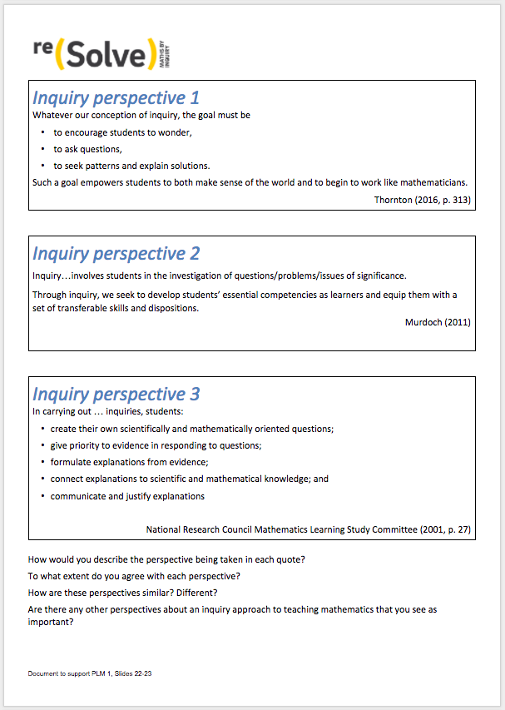
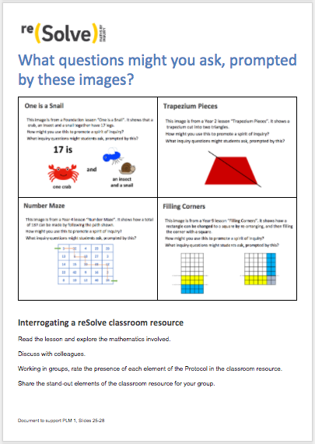
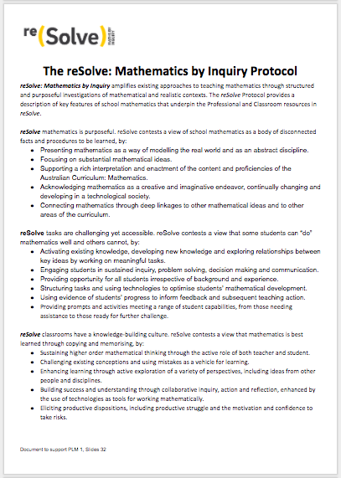
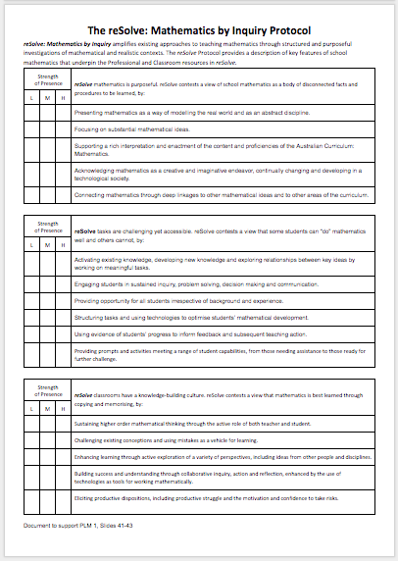
Hand-outs needed
Notes:
Hand-out of support documents at https://docs.google.com/document/d/1k8d3-YBTaegsUUzLC46E9eoOrEPzzJJAJJsWS_F4vcI/edit?usp=sharing.

Slide 3

Which 3 of these statements are the highest priority for you? Mathematical experiences should …
require sustained thinking by the student
require students to spend time on sustained problem solving and reasoning
focus attention onto substantial mathematical ideas
allow students opportunity to be creative
activate existing knowledge
foster the development of new knowledge
challenge existing conceptions
allow collaborative action and reflection
help students connect ideas within mathematics
help students connect ideas between mathematics and other domains
allow students decide on their own solutions and/or solution strategies

Slide 4
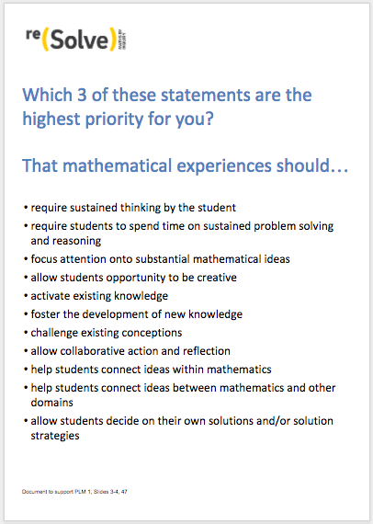
Which three of these statements are the highest priority for you? Mathematical experiences should …
Select your three priorities, and explain to your group. Discuss the thinking behind your choices.

Slide 5
Professional Learning Module 1 reSolve: Mathematics by Inquiry
Introducing the reSolve Protocol and some of the resources.

Slide 6
Module overview
Part 1: The elements of the reSolve project
Part 2: The spirit of inquiry in the reSolve project
Part 3: Understanding the reSolve Protocol
Part 4: Reading and interpreting classroom resources
using the reSolve Protocol
Part 5: Planning a specific classroom trial
Part 6: Conclusion

Slide 7
Part 1: The elements of the reSolve project

Slide 8
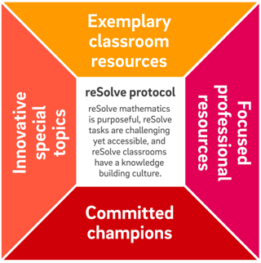
Overview of the reSolve: Mathematics by Inquiry Project

Slide 9
The reSolve Protocol is the driver for all that the project is about, and does.
In order to foster a spirit of inquiry in all mathematics teaching and learning:
reSolve mathematics is purposeful
reSolve tasks are challenging yet accessible
reSolve classrooms have a knowledge-building culture

Slide 10
Classroom Resources
Exemplary classroom resources at every level from Foundation to Year 10 that embody a spirit of inquiry and that enact the reSolve Protocol.

Slide 11



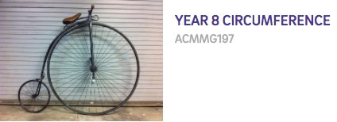
Classroom Resources

Slide 12
Special Topics
Addressing identified needs or exploring new boundaries.
Special Topics are a significant resource within the reSolve classroom resources that address the needs of 21st century learners. They:
are substantial units of work and accompanying resources that address some major current gaps
prioritise the Australian Curriculum proficiencies of reasoning and problem solving,
provide imaginative opportunities for creatively using new technologies and real world contexts,
respond to the results of international assessments showing that solving real problems is a specific area of weakness for Australian students.

Slide 13
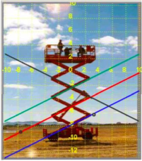

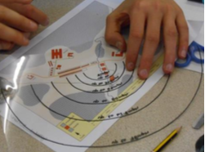
Special Topics
Mechanical Linkages and Deductive Geometry | Bringing the Real World into Algebra | Modelling Motion | Bar Model Method
Assessing Reasoning | Mathematics and Algorithmic Thinking | Mathematical Modelling | Mathematical Inquiry into Authentic Problems

Slide 14
Professional Learning Modules
Resources to support in-school leaders to address key issues and themes in the teaching and learning of mathematics through collegial professional learning programs.

Slide 15
Professional Learning Modules
PLM 1: reSolve: Mathematics by Inquiry Introducing the reSolve Protocol and some of the resources | PLM 2: Mathematical purpose and potential | PLM 3: Including all students in mathematics learning experiences | PLM 4: The role of challenging mathematical experiences in activating thinking of all students.
PLM 5: Using student strategies and solutions as part of inquiry learning in mathematics | PLM 6: Leading the incorporation of inquiry approaches into mathematics teaching repertoires: A workshop for current and potential leaders | PLM 7: Activating mathematical thinking then consolidating learning | PLM 8: Adapting existing inquiry resources and creating your own

Slide 16
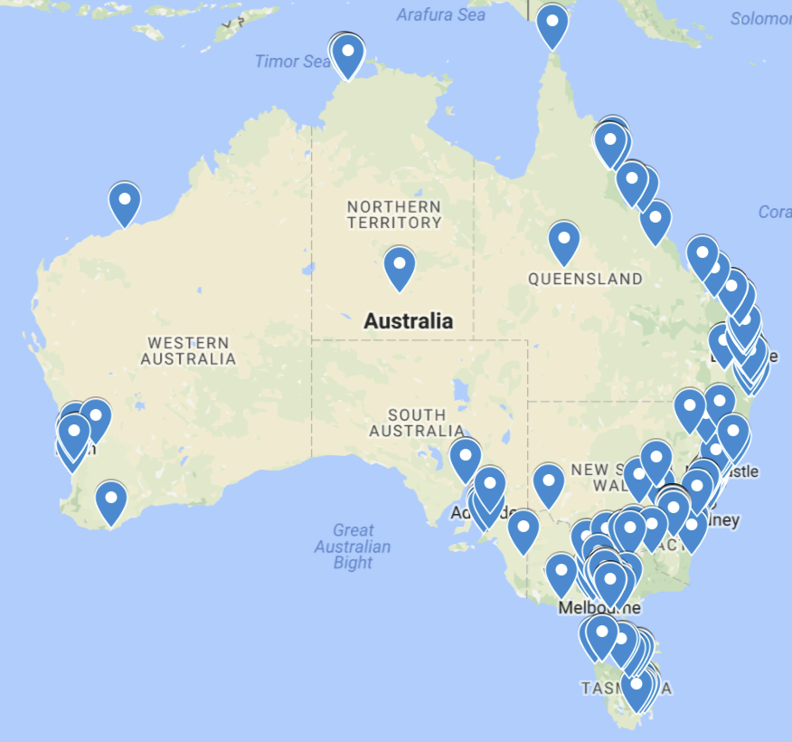
reSolve Champions
A community of more than 290 committed leaders across the country, who will use reSolve resources and approaches in professional learning programs they lead during and after the development phase of reSolve (finishes mid-2018).

Slide 17
Part 2: The spirit of inquiry in the reSolve Project

Slide 18
There are different views of inquiry.
Consider the following three perspectives.

Slide 19
Inquiry perspective 1
Whatever our conception of inquiry, the goal must be
to encourage students to wonder,
to ask questions,
to seek patterns and explain solutions.
Such a goal empowers students to both make sense of the world and to begin to work like mathematicians.
Thornton (2016, p. 313)

Slide 20
Inquiry perspective 2
Inquiry…involves students in the investigation of questions/problems/issues of significance.
Through inquiry, we seek to develop students’ essential competencies as learners and equip them with a set of transferable skills and dispositions.
Murdoch (2011)

Slide 21
Inquiry perspective 3
In carrying out … inquiries, students:
create their own scientifically and mathematically oriented questions;
give priority to evidence in responding to questions;
formulate explanations from evidence;
connect explanations to scientific and mathematical knowledge; and
communicate and justify explanations
National Research Council Mathematics Learning Study Committee (2001, p. 27)

Slide 22
Three perspectives on inquiry...

Slide 23
Three perspectives on inquiry...
How would you describe the perspective being taken in each quote?
To what extent do you agree with each perspective?
How are these perspectives similar? Different?
Are there any other perspectives about an inquiry approach to teaching mathematics that you see as important?

Slide 24
The following contain some images from reSolve resources.

Slide 25
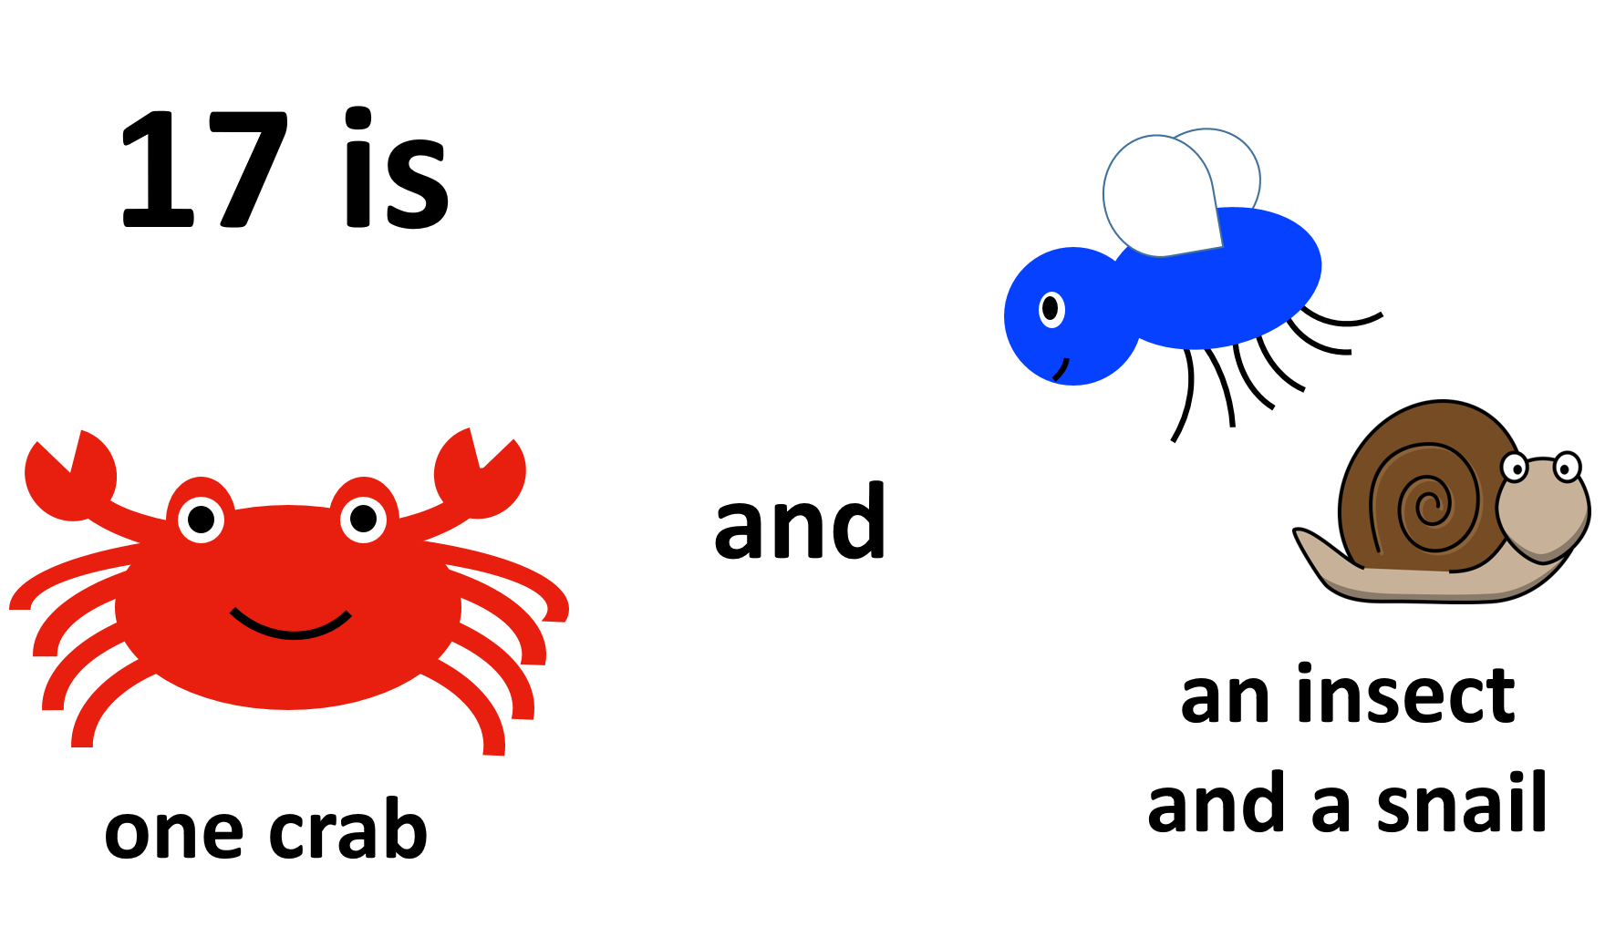
One is a Snail
This image is from a Foundation lesson “One is a Snail”. It shows that a crab, an insect and a snail together have 17 legs.
How might you use this to promote a spirit of inquiry?
What inquiry questions might students ask, prompted by this?

Slide 26

Trapezium Pieces
This image is from a Year 2 lesson “Trapezium Pieces”. It shows a trapezium cut into two triangles.
How might you use this to promote a spirit of inquiry?
What inquiry questions might students ask, prompted by this?

Slide 27
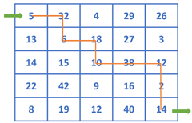
Number Maze
This image is from a Year 4 lesson “Number Maze”. It shows how a total of 137 can be made by following the path shown.
How might you use this to promote a spirit of inquiry?
What inquiry questions might students ask, prompted by this?

Slide 28
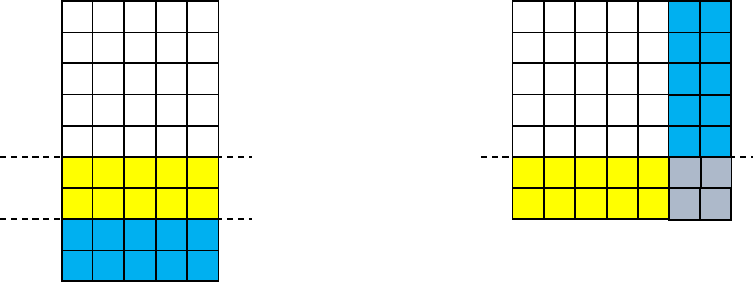
Filling Corners
This image is from a Year 9 lesson “Filling Corners”. It shows how a rectangle can be changed to a square by re-arranging, and then filling the corner with a square.
How might you use this to promote a spirit of inquiry?
What inquiry questions might students ask, prompted by this?

Slide 29
What questions might you ask, prompted by these images?

Slide 30
Part 3: Understanding the reSolve Protocol

Slide 31
The three aspects of the reSolve: Mathematics by Inquiry Protocol
reSolve mathematics is purposeful
reSolve tasks are challenging yet accessible
reSolve classrooms have a knowledge-building culture

Slide 32
The reSolve Protocol

Slide 33
The reSolve Protocol
The purpose of the Protocol is to provide:
  the principles that underpin the reSolve project
  a vision for mathematics teaching and learning more generally
In this part, you will see and hear some statements on the three elements of the Protocol.

Slide 34
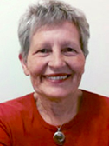
reSolve mathematics is purposeful
Emeritus Professor
Kaye Stacey
https://youtu.be/9OlK4tBrHAM

Slide 35

reSolve tasks are challenging yet accessible
Dr Steve Thornton
https://youtu.be/syPsEmWABOc

Slide 36
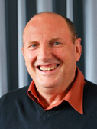
reSolve classrooms have a knowledge-building culture
Emeritus Professor
Peter Sullivan
https://youtu.be/OPxq3KT2fHU

Slide 37
Part 4: Reading and interpreting classroom resources using the reSolve Protocol

Slide 38
Visit the reSolve website, and choose a classroom resource that you might teach.
EXPLORE RESOURCES
MEMBERS
5 - 8
F - 4, 9 - 10
Special Topics

Slide 39
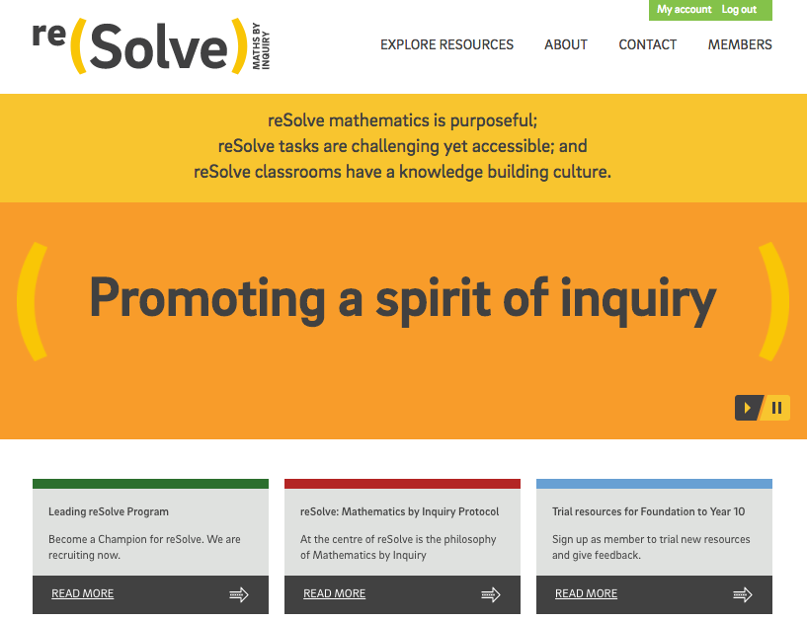
http://resolve.edu.au

Slide 40
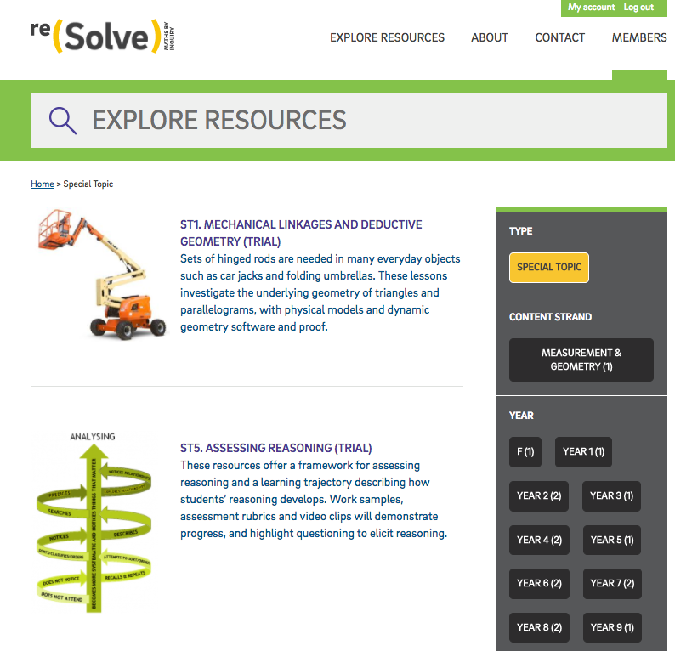
Also in the Members’ area of the reSolve website are draft versions of the Special Topics. You may want to consider classroom activities from this collection.

Slide 41
Interrogating a reSolve classroom resource
Read the lesson and explore the mathematics involved.
Discuss with colleagues.
Working in groups, rate the presence of each element of the Protocol in the classroom resource.
Share the stand-out elements of the classroom resource for your group.

Slide 42
Interrogating a reSolve classroom resource
Work in groups to identify how well each element of the Protocol is represented in the resource.

Slide 43
Interrogating a reSolve classroom resource
Read the lesson and explore the mathematics involved.
Discuss with colleagues.
Working in groups, rate the presence of each element of the Protocol in the classroom resource.
Share the stand-out elements of the classroom resource for your group.

Slide 44
Advice for teachers when reading reSolve resources
Consider the experience of looking at a reSolve resource.
List 3 tips for teachers to think about when reading the documentation of resources in order to appreciate and evaluate the intent and potential of the resource.

Slide 45
Part 5: Planning a specific classroom trial

Slide 46
The Protocol into practice
The purpose of this part is for you to:
focus on specific aspects of the Protocol that are important for your practice
design a classroom trial to explore the resource that you examined earlier

Slide 47
Your priorities
Revisit your three priorities from before…
Do your priorities fit in the Protocol?
Would you change your priorities, having now seen the full Protocol?
What will be your three priorities in your classroom trial?

Slide 48

Planning a classroom exploration
In planning to use the classroom resource you examined earlier, consider how:
  this resource will foster a spirit of inquiry
  you will use the resource to focus on your priorities
  you will know what the students have learnt, and where to go next

Slide 49
Part 6: Conclusion

Slide 50
The goals of this Module were to:
introduce the reSolve: Mathematics by Inquiry project and its various elements
introduce the notion of a spirit of inquiry that permeates the reSolve resources, and engage you in a reSolve activity
view the resources generally and examine one resource in detail
introduce the reSolve Protocol and discuss its various elements
encourage you to commit to a classroom trial as a result of the module

Slide 51
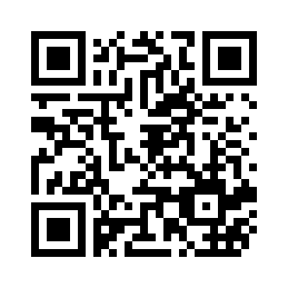
Evaluating this Professional Learning Module
https://www.surveymonkey.com/r/reSolvePD1evaluation

